Slide 2
THE DERIVATIVES MARKET’S PAYMENT PRIORITIES AS FINANICAL CRISIS ACCELERATOR
Mark J. Roe

Slide 3
AGENDA
CHAPTER 11 SUPERORIORITIES FOR DERIVATIVES AND REPOS
  The Code
  The AIG, Bear, and Lehman Failures in the light of the Code
CODE-INDUCED DISINCENTIVES TO MARKET DISCIPLINE
  Incentives and Disincentive for Market Discipline
  The Code-Induced Weakening of Market-Discipline Mechanisms
  Runs and Contagion
WHY CONTRACT CANNOT SOLVE COUNTERPARTY RISK
  Contractual Reaction and Its Limits
  The Regulatory Reaction Needed
WHAT THE DODD-FRANK FINANCIAL REFORMS DO AND FAIL TO DO

Slide 4
THE CODE
Bars the debtor’s creditors from collecting on their loans from the bankrupt debtor
Requires creditors who get themselves repaid on the eve of bankruptcy return the assets seized or payment made
Requires fraduluent conveyances be recaptured by the debtor
Allows the debtor, but not the creditor, to affirm or reject outstanding contracts

Slide 5
THE CODE FOR CREDITORS HOLDING DERIVATIVES AND REPURCHASE AGGREEMENTS
Allows counterparties to immediately collect on their debts at the beginning of a bankruptcy
Allows them to keep eveof-bankruptcy preferential payments on old debts
Exempts them from most fraudulent conveyance liability
Allows derivatives counterparties to choose whether or not to terminate contracts.

Slide 6
“The Code favors the derivatives and repo players with exemptions, insulations, and special treatment”

Slide 7
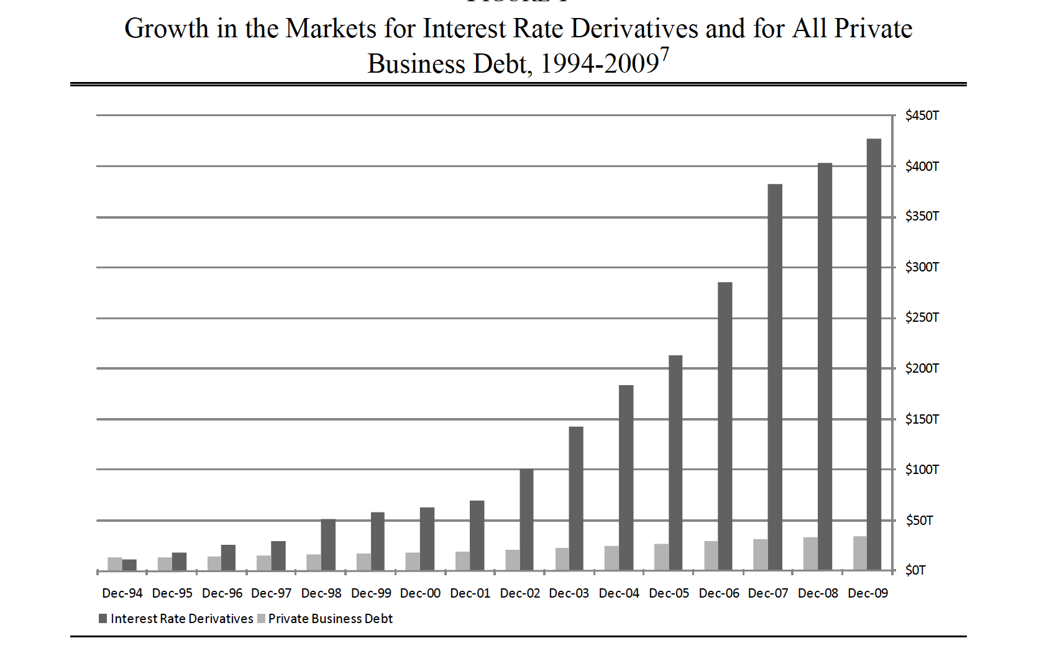

Slide 8
AIG
AAA Rating
$400 billion of credit default obligations VS. $100 billion total equity
“It seems shocking to me that Goldman would become so exposed to AIG and kept doing deals with them and laying on the risk.”
------- a former chief of AIG’s financial products unit
It post generous collateral if the value of the insured securities dropped or if its own credit rating fell

Slide 9
Bear Stearns
It extensively relied on repos to finance itself
With $400 billion in assets when it failed, a quarter of Bear’s values was in the repo market
Repos is eight times Bear’s total equity captial
Counterparties were less concerned with Bear’s viability and liquidity

Slide 10
Lehman
J.P. Morgan froze $17 billion of Lehman cash and securities that J.P. Morgan held, and then demanded $5 billion more in collateral
Reserve Fund, as one of Lehman’s creditors, collapsed afterward
The Treasury felt compelled for a time to guarantee all money market funds during the financial crisis

Slide 11
  INCENTIVES AND DISINCENTIVE FOR MARKET DISCIPLINE
Counterparties often have needed skills, but limited incentives
Exposed creditors have incentives, but limited skills
The United States of America as missing creditor
The quandary of the bystander creditor

Slide 12
THE CODE-INDUCED WEAKENING OF MARKET DISCIPLINE MECHANISMS
Market discipline by counterparty monitoring
By raising prices
By dealing only with strong counterparties
By reducing exposure to a single counterparty
By substituting into stronger financing structures
By moving from overnight repos to longer-term financing
By setting better margin coverage earlier

Slide 13
RUN AND CONTAGION
AIG: collateral calls, runs, and private lenders’ refusal to lend
Information Contagion
  Creditors are poorly informed about their counterparties’ financial health
Collateral Contagion
  A simultaneous effort across financial markets to sell collateral and debtor assets

Slide 14
WHY CONTRACT CANNOT SOLVE COUNTERPARTY RISK
Contractual Reaction and Its Limits
  Demand collateral sooner
  Contractual reaction may be an arms race
The Regulatory Reaction Needed
  Counterparty can net unrelated trades, as long as they can be called derivatives or repucrhcase agreements
  United States as de facto guarantor

Slide 15
WHAT THE DODD-FRANK FINANCIAL REFORMS DO AND FAIL TO DO
Mandates a clearinghouse or exchange for many derivatives
Clearinghouse weaknesses
  Is it properly incentivized?
  Many types of derivative cannot be handled by a clearinghouse
  Risk transfer to creditors outside the exchange’s netting mechanism
  Clearinghouse’s reaction speed

Slide 16
CONCLUSION
Chapter 11 makes exception to derivatives and repo counterparites
The privileged capacity can induce a run on the failing financial institution
The exemption can exacerbate collateral contagion and information contagion
The years prior to the crisis: derivatives players’ advantages undermine prebankruptcy market-discipline incentives
Ongoing financial crisis: privileges accelerate and transmit financial instability

Slide 17
MY OPINIONS
Superpriorities and blanket exceptions negatively undermine derivatives and repo players’ incentives
The difficulty to transit and change the Code
  Opposition from groups benefit from the superpriorities
  Lobbying
  Costs of change

